Slide 1
Azure DevOps
Shawn Weisfeld
Sr. Cloud Solution Architect
Microsoft

Slide 2







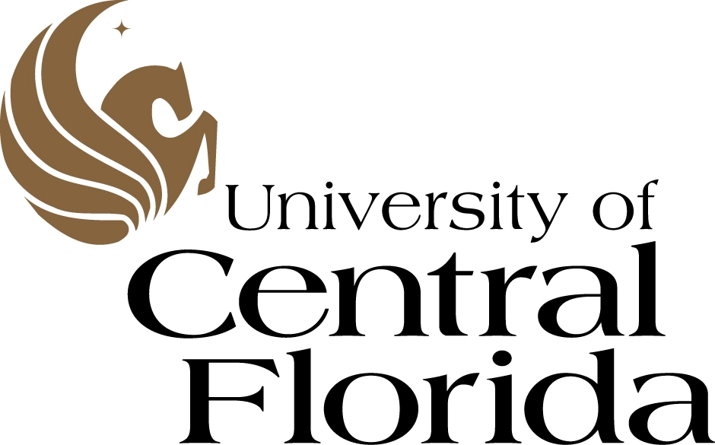






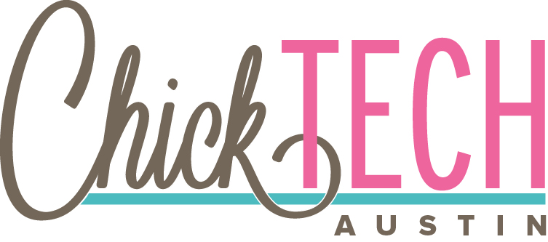





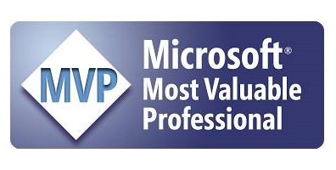
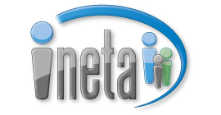

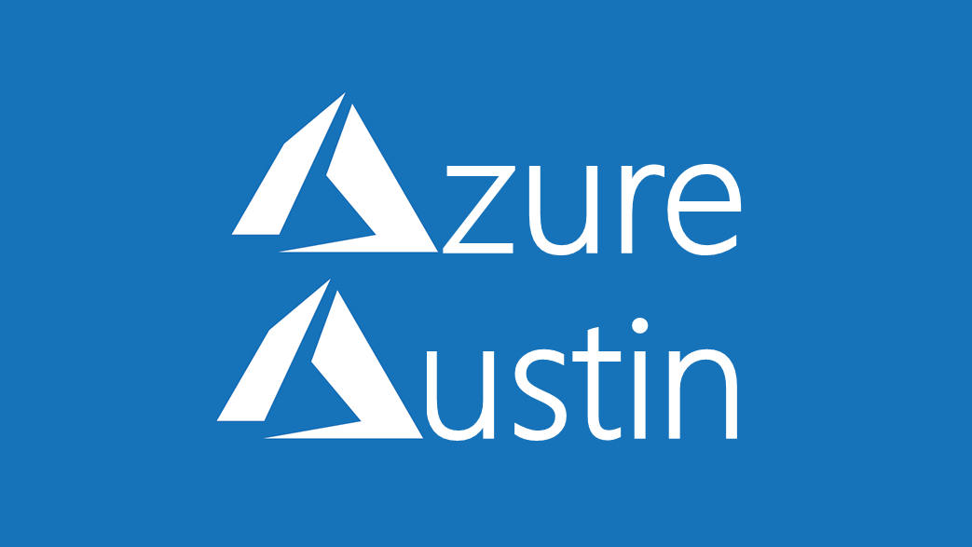

Slide 3
Today’s Agenda (all times Eastern)
10:00 AM – 11:00 AM: Overview/Introduction
11:00 AM – 11:45 AM: Whiteboard Design Session
11:45 AM – 12:15 PM: Lunch
12:15 PM – 1:30 PM: Azure DevOps Hands On Lab
1:30 PM – 2:00PM: Update from Skip
2:00 PM – 2:30 PM: Azure DevOps Hands On Lab (cont.)

Slide 4
WHAT IS DEVOPS?
(i.e. the process, dev tools and cloud vendor/deployment target agnostic)

Slide 5

What is DevOps?
“Development and operations collaboration”
“Automation”
“Faster and smaller releases”
“A job title”
Notes:
So, what is DevOps exactly?
DevOps is a term for a group of concepts that, while not all new, have catalyzed into a movement and are rapidly spreading.
Like any new and popular term, people have different and sometimes contradictory perceptions of what it is.
Currently, DevOps is more like a philosophical movement, and not yet a precise collection of practices, descriptive or prescriptive (e.g., CMM-I, ITIL, Agile, etc.).
In his book The Phoenix Project, Gene Kim, an important DevOps influencer, describes a model how an IT organization can transition to a DevOps model to facilitate fast, rapid, reliable flow of features into production and, ultimately, into the hands of users.

Slide 6
Common software delivery challenges
Low deployment frequency
High lead time for changes
!
High change failure rate
Long mean time to recover

Slide 7
High performance DevOps companies achieve…
46x deployment frequency
2,555x faster lead time for changes
DevOps
Faster time to market
Increased revenue
7x lower change failure rate
2,604x faster mean time to recover
Source: 2018 Accelerate: State of DevOps: Strategies for a New Economy." N. Forsgren, J. Humble, G. Kim. DevOps Research and Assessment (DORA)
Notes:
According to the 2018 State of DevOps Report, presented by DORA, high performing DevOps companies when compared to low performers achieve:
46x more frequent deployments
2,555x faster lead time for changes
2,604x faster mean time to recover
7x lower (1/5 as likely) change failure rate
Additionally, according to the Global Study by CA Technologies, Organizations realizing up to 20% improvements in not only software quality, deployment frequency etc....
Software quality
Frequency of deployment
Time to market
Increased Revenue
Customer reach and retention

Slide 8
What is DevOps?
People. Process. Products.
Build& Test
Deploy
DevOps is the union of people, process, and products to enable continuous delivery of value to your end users.
“
Continuous Delivery
Develop
Operate
”
Plan & Track
Monitor & Learn

Slide 9
What technologies do I need to support DevOps?
DevOps brings together people, processes, and products, automating software delivery to provide continuous value to your users. Using Azure DevOps, you can deliver software faster and more reliably - no matter how big your IT department or what tools you’re using.
Continuous integration (CI)
Improve software development quality and speed.
When you use Azure Pipeliens or Jenkins to build apps in the cloud and deploy to Azure, each time you commit code, it’s automatically built and tested and bugs are detected faster.
Continuous Deployment (CD)
By combining continuous integration and infrastructure as code (IaC), you’ll achieve identical deployments and the confidence to deploy to production at any time.
With continuous deployment, you can automate the entire process from code commit to production if your CI/CD tests are successful.
Continuous Learning & Monitoring
With Azure Application Insights you can identify how your applications are performing and test if the recent deployment made things better or worse.
Using CI/CD practices, paired with monitoring tools, you’ll be able to safely deliver features to your customers as soon as they’re ready.

Slide 10
If It Hurts, Do It More Often
Develop
Find what hurts and keep doing it a bit better
Find the part of your process in getting value to customers that slows you down or hurts the most. Make it incrementally better each sprint. Re-evaluate and improve the next most painful.
“
Collaborate
”
Deliver
Operate
Notes:
DevOps is the union of people, process and products to enable the continuous delivery of value to your end customers

Slide 11
Regardless of what DevOps tools or development language you pick the Microsoft Cloud Platform is here to help!

Slide 12
The Microsoft Cloud Platform
Microsoft Azure is a powerful and flexible foundation for past, present, and future apps – easily build, manage, and deploy any application and any stack on a massive, global network using your favorite tools and frameworks.
Flexible
Powerful
Open
Choice of IaaS, PaaS, public cloud or hybrid.
Mirror or modernize app infrastructure with VMs, containers, microservices or serverless.
Supports all stages of the app modernization journey – from lift-and-shift to Cloud-Native.
Instantly improve the performance, scalability and resiliency of your apps by moving them to the cloud.
Increase business agility with Cloud-Native capabilities and built-in DevOps for continuous innovation.
Bring your stack, we bring a cloud that runs any app, on any platform, and any language.
Build applications using the language and tools of your choice - Azure supports what you already use and love so you can get up and running fast – just bring code.

Slide 13
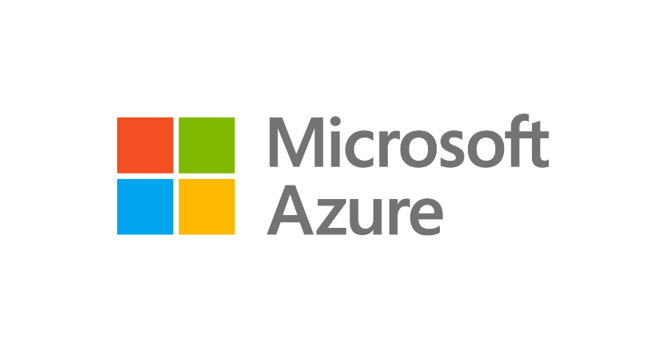

Develop
GitHub
Visual Studio
Visual Studio Code
Innovate at scale.
Deliver with confidence.
Microsoft Azure is the cloud with DevOps tooling built in
Operate
Deliver
Azure Monitor
Azure Policy
Azure Automation
Azure Security Center
Azure Boards
Azure Repos
Azure Pipelines
Azure Artifacts
Azure Test Plans
Azure Lab Services
Notes:
So, we’ve just run through our overall solution and how this addresses all four areas that enable you to innovate at scale, and deliver with confidence. We looked at how you can use:
Visual Studio and Visual Studio code to maximize developer efficiency
GitHub to accelerate collaboration and open source development practices
Azure DevOps to accelerate delivery of your products and
Azure Security & Management services to ensure your products operate reliably, scale and remain secure

Slide 14
Azure is just where the Azure DevOps Service runs. The tool facilitates deploying wherever makes sense for your project.

Slide 15




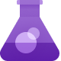
Deliver
with Azure DevOps
Azure Boards
Azure Repos
Azure Pipelines
Azure Artifacts
Azure Test Plans

Slide 16
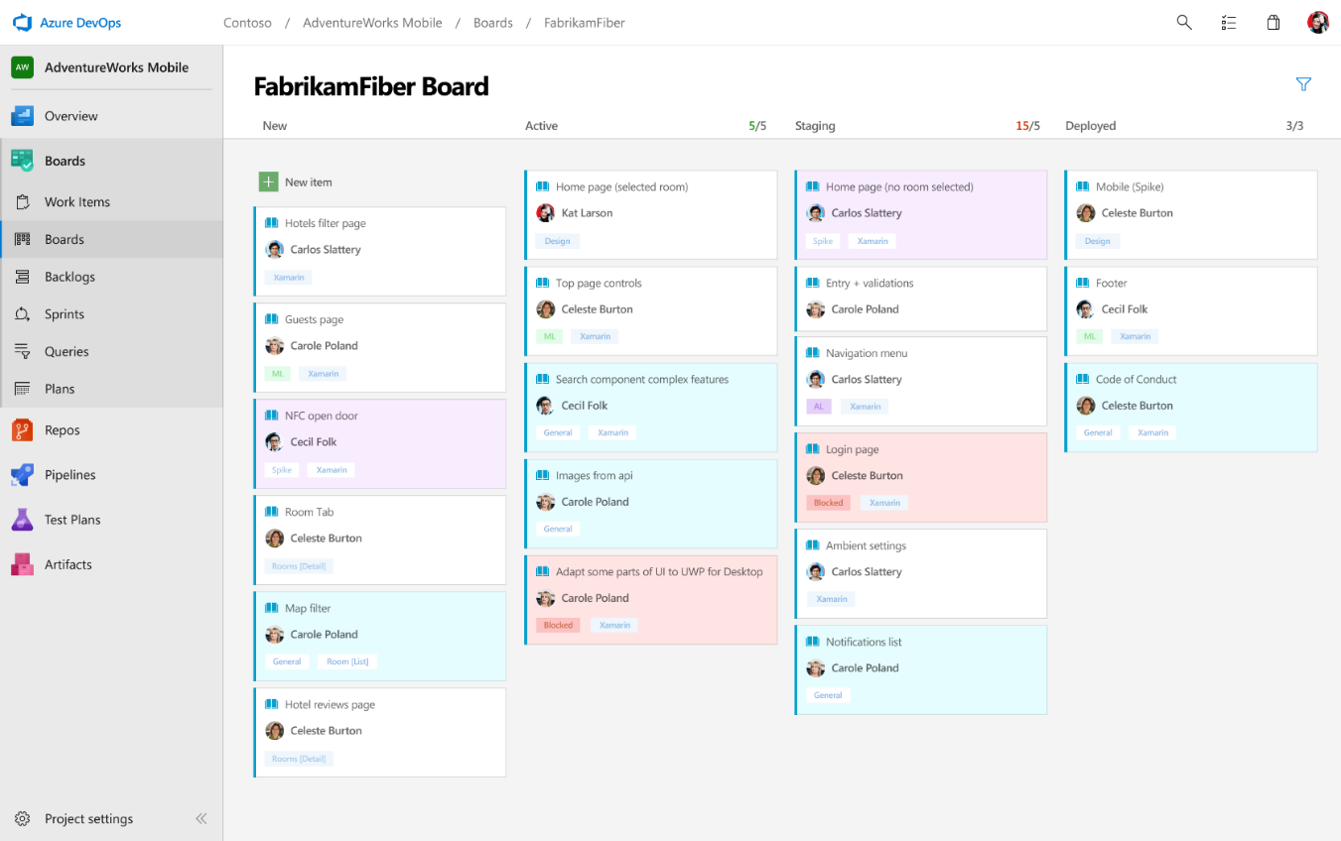
Boards
Azure Boards
Azure Repos
Azure Pipelines
Connecting ideas to releases
Scrum ready to help your teams run sprints, stand-ups, and plan work
Integrated with GitHub commits and pull requests
Insights into project status and health
Azure Artifacts
Azure Test Plans

Slide 17
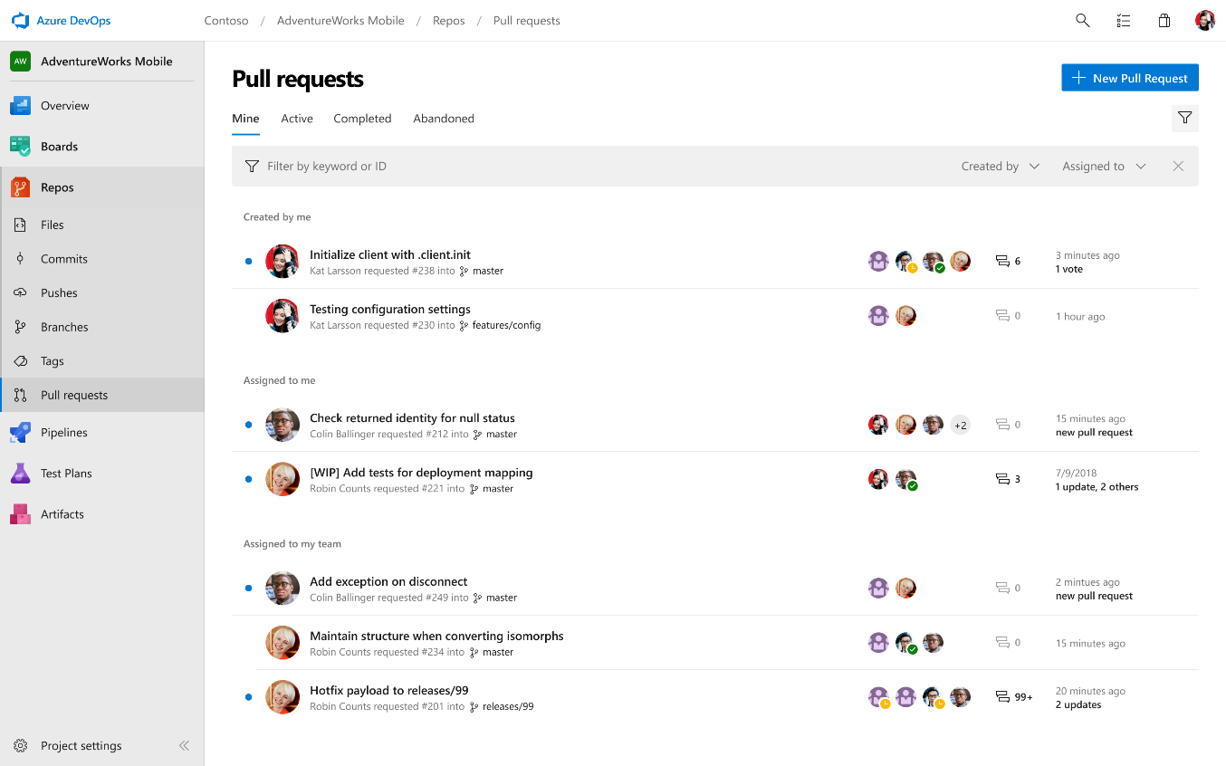
Repos
Azure Boards
Azure Repos
Azure Pipelines
Private Git and TFVC repos for your teams
Code review via branch pull requests
Branch policies and build validation
Easy migration path to / from GitHub
Azure Artifacts
Azure Test Plans

Slide 18
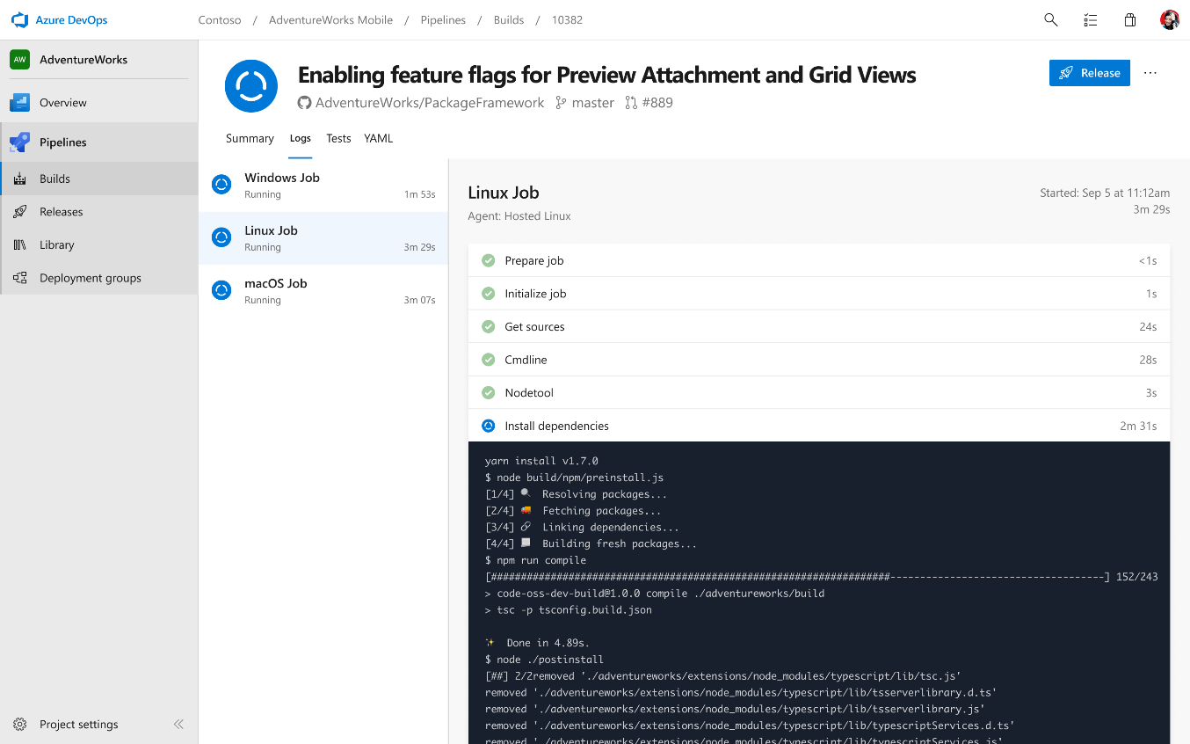
Pipelines: Build
Azure Boards
Azure Repos
Azure Pipelines
Cloud-hosted pipelines for Linux, macOS and Windows
Any language, any platform, any cloud
Native support for containers and Kubernetes
Best-in-class for open source
Azure Artifacts
Azure Test Plans

Slide 19
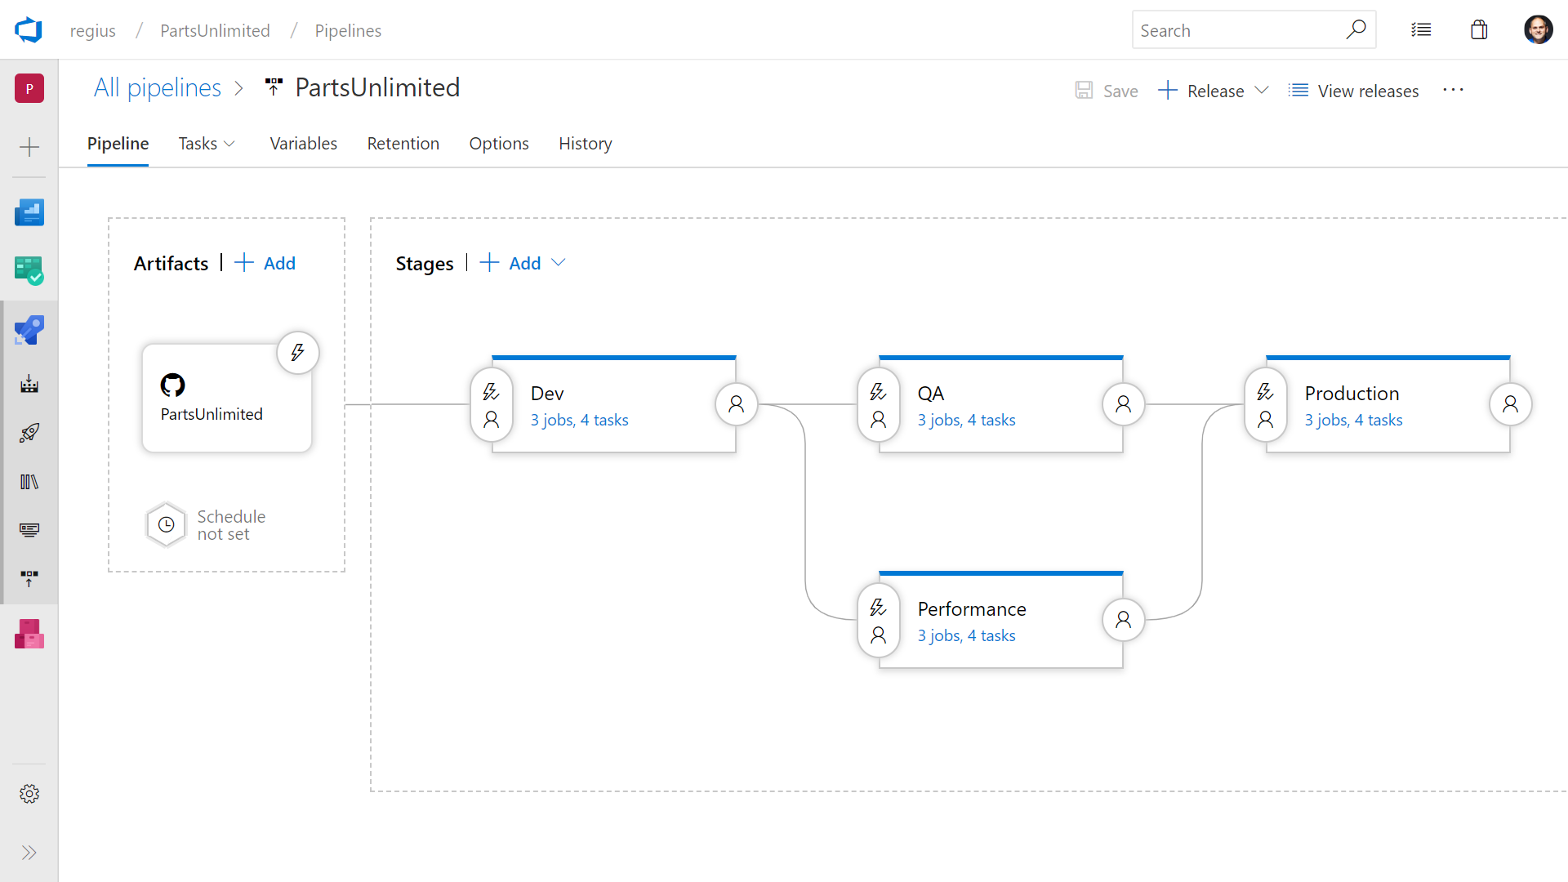
Pipelines: Release
Azure Boards
Azure Repos
Azure Pipelines
Deploy to on-premises, ANY cloud or a hybrid of cloud and on-prem
Staged environment releases
Pre and post deployment approvals with gates to automate approval based on conditions
Azure Artifacts
Azure Test Plans

Slide 20
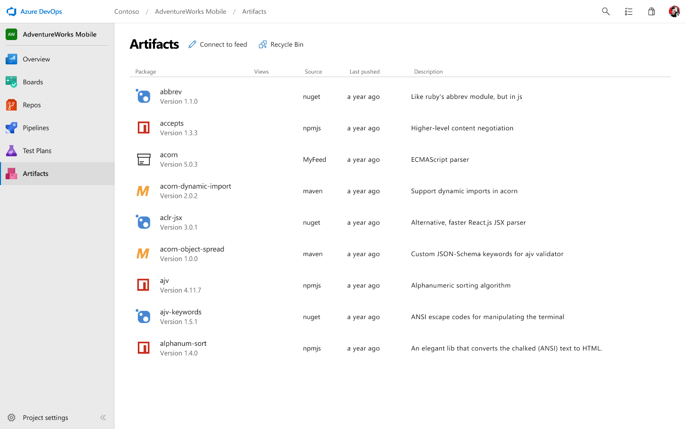
Artifacts
Azure Boards
Azure Repos
Azure Pipelines
Share code efficiently
Keep your Maven, npm, NuGet and Python packages and more in the same place
Aggregate from public registries and internal teams
Publish and track from any pipeline
Azure Artifacts
Azure Test Plans

Slide 21
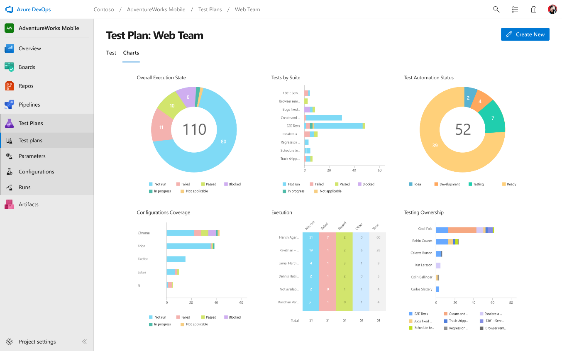
Test Plans
Azure Boards
Azure Repos
Azure Pipelines
Run tests and log defects from your browser
Track and assess quality throughout your lifecycle
Capture rich data for reproducibility
Create tests directly from exploratory sessions
Azure Artifacts
Azure Test Plans

Slide 22

GitHub
Azure Boards
GitHub brings the premier social coding workflows to your team, breaking down silos and enabling Inner Source through:
Expertise sharing
Cross-team collaboration
Improved code reuse
Increased velocity
Azure Repos
Azure Pipelines
Azure Artifacts
Azure Test Plans

Slide 23

The #1 developer community on the planet
Most contributions 1.1B in 2018
Most developers 33M
Most Repos 100M
Most secure 5M vulnerability alerts in 2018
Notes:
In fact, Github is the #1 developer platform on the planet
GitHub has long been known as the home of the largest open source community in the world and it continues to grow.
In 2018, open source developers made more than 1.1 billion updates to 96 million repositories on GitHub.
GitHub’s dominance in open source is the result of their intense focus on developers.
Developers choose GitHub because it focuses on providing the best possible environment for building code, whether that’s alone or together.
GitHub allows hundreds, even thousands, of developers to contribute to the same code base without fear of losing or overwriting work.
After seeing the successful projects being built in the open source communities, organization of all shapes and sizes took notice.
Today, GitHub is meeting the demands of some of the most challenging business environments, including highly regulated industries from automotive and finance, to farming and medicine.

Slide 24

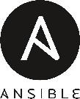
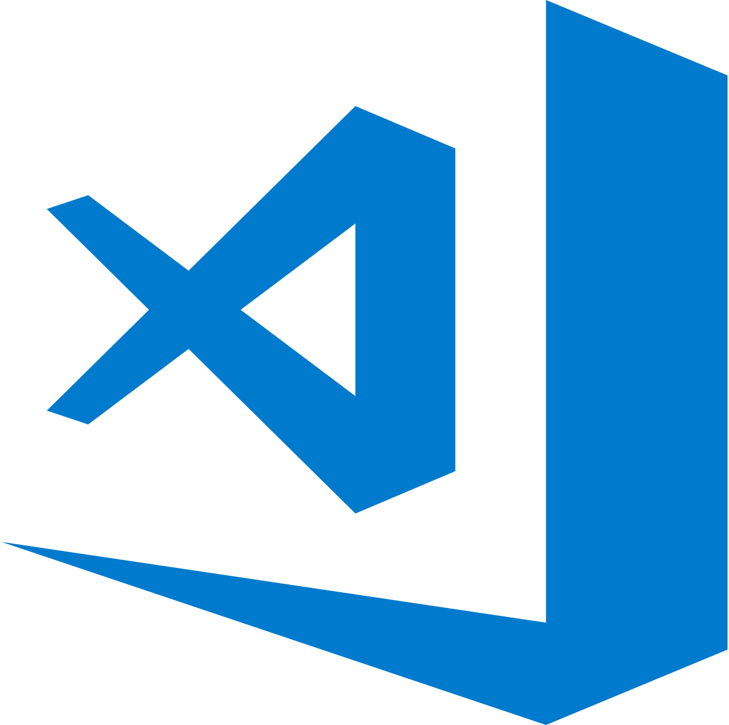

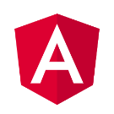
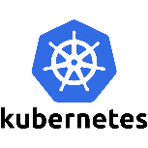
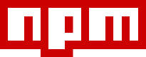

Home to the most important and popular open source projects on the planet
Notes:
GitHub is also home to the most important and popular open source projects on the planet
From the Linux kernel itself, Kubernetes and through to today’s most popular languages and frameworks such as Go, Angular, React and .NET core
With almost all IT solutions these days taking a dependency on open source projects, it’s likely that these projects live on GitHub.
This makes GitHub, the best place for your company to participate in these projects, even if it’s just keeping your finger on the pulse or the ability to raise issues

Slide 25


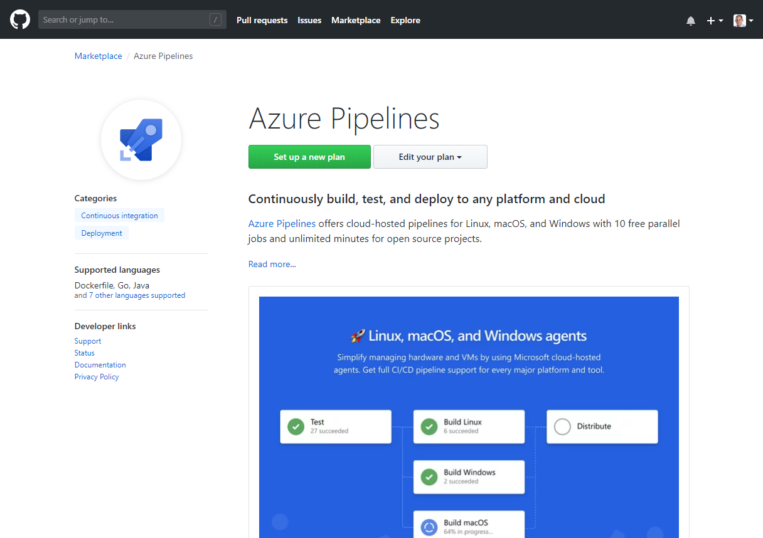
Azure DevOps Integrated with GitHub
Rich integration with Azure Pipelines and Azure Boards

Slide 26


Azure Pipelines
Microsoft Open Source
Free unlimited build minutes for public projects
Up to 10 free parallel jobs across Windows, Linux and macOS
➔
https://azure.com/pipelines
Notes:
All the builds you need, using the power of Azure you get one service that gives you unlimited build minutes where you can build on Windows Mac and Linux in parallel using a single build YAML file.

Slide 27
The DevOps tool suite is not all or nothing, use the entire suite, or pick and choose what make sense for your team.

Slide 28



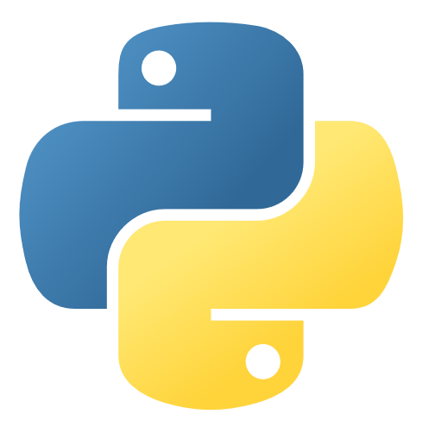
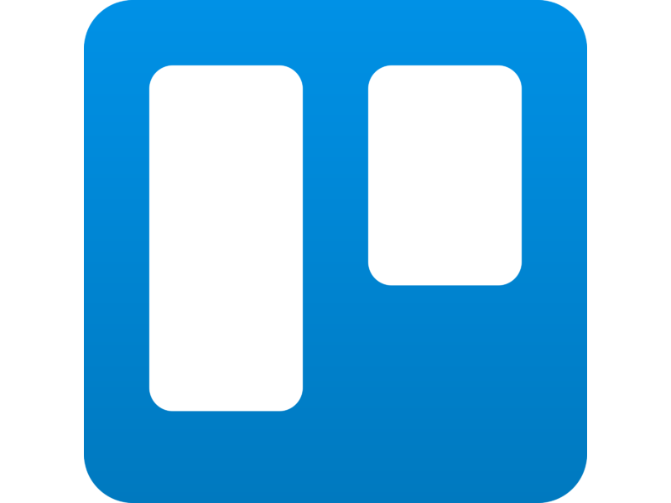
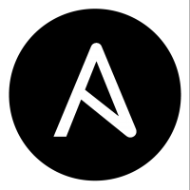

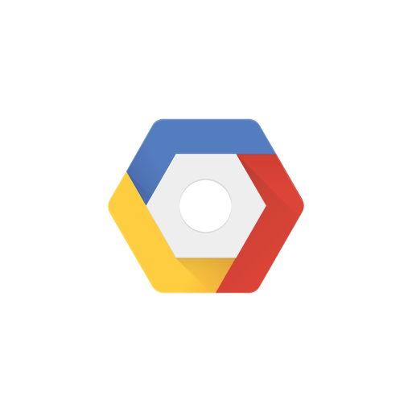

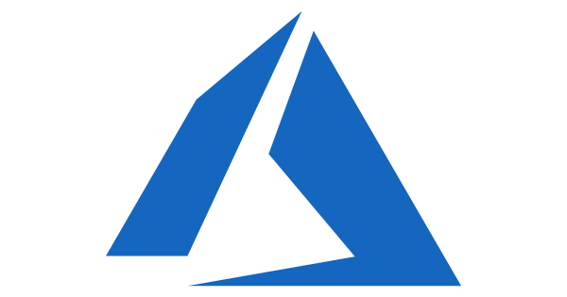


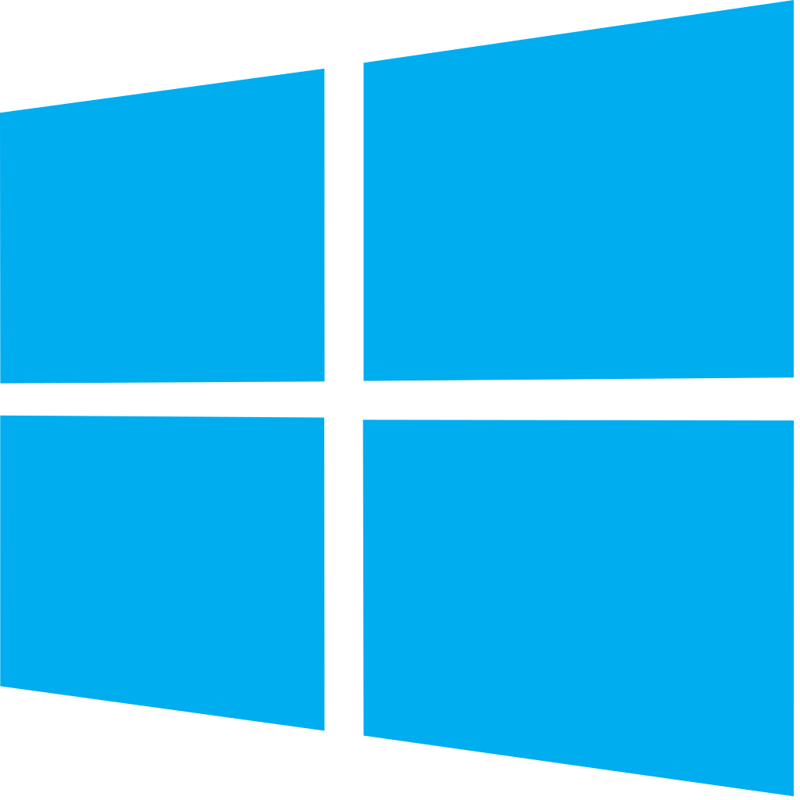


Azure DevOps: Choose what you love
Any Language, Any Platform
Azure DevOps lets developers choose the tools and languages that are right for them
Mix and match to create workflows with tools from Microsoft, open source or your favorite 3rd party tools
Target any cloud, on-prem or both and deploy to the servers you need

Slide 29
Tech use case details & architecture

Slide 30
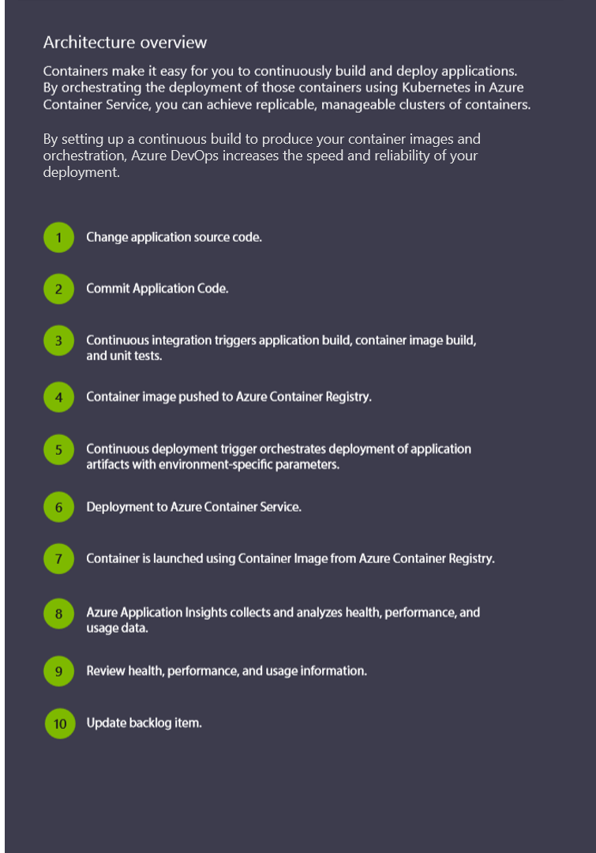
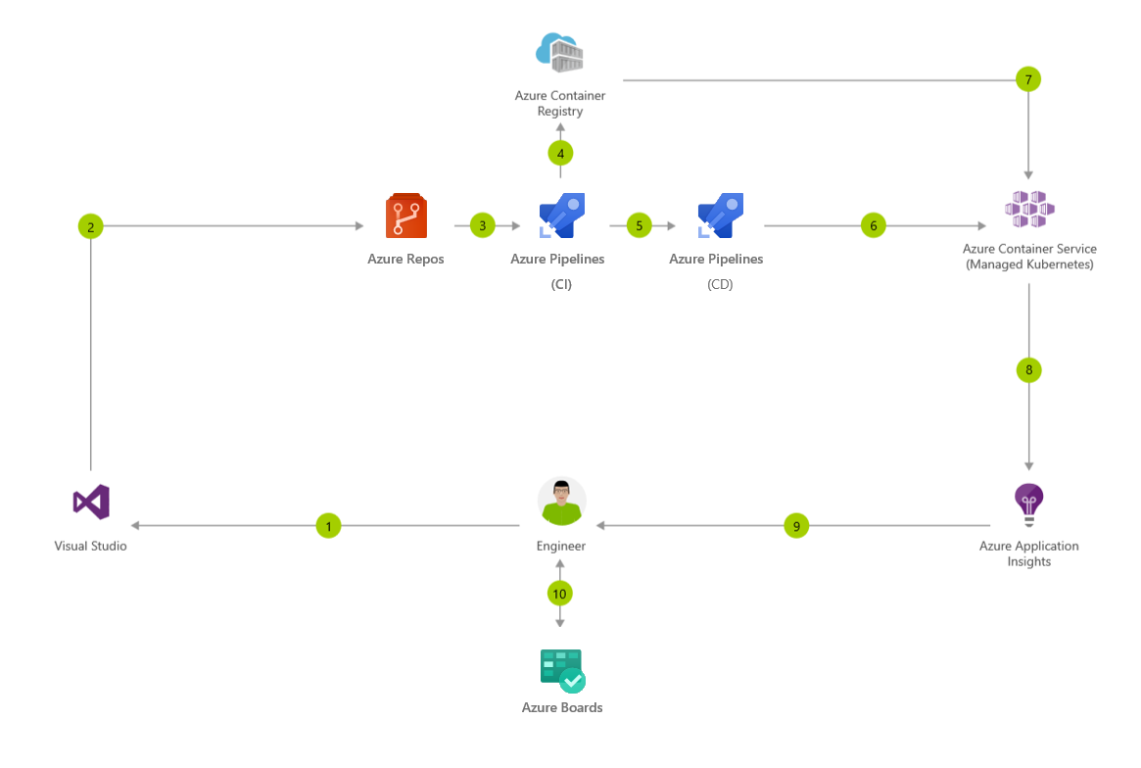
CI/CD for Containers

Slide 31
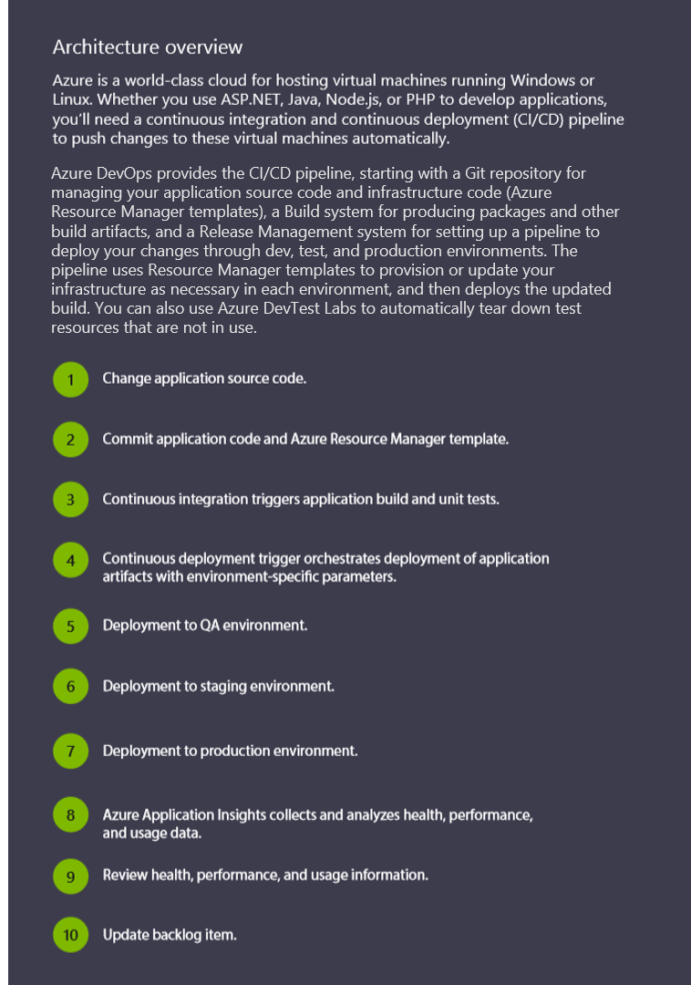
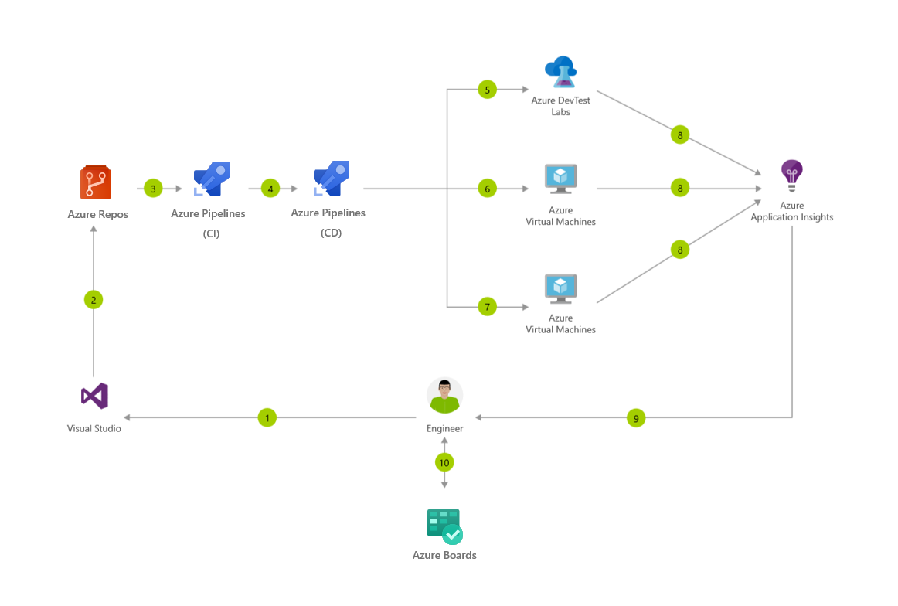
CI/CD for Azure Virtual Machines

Slide 32
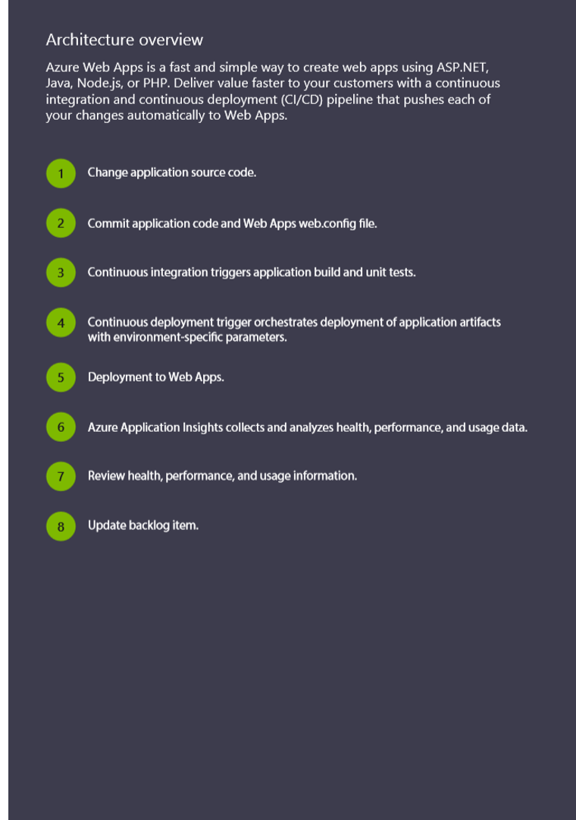
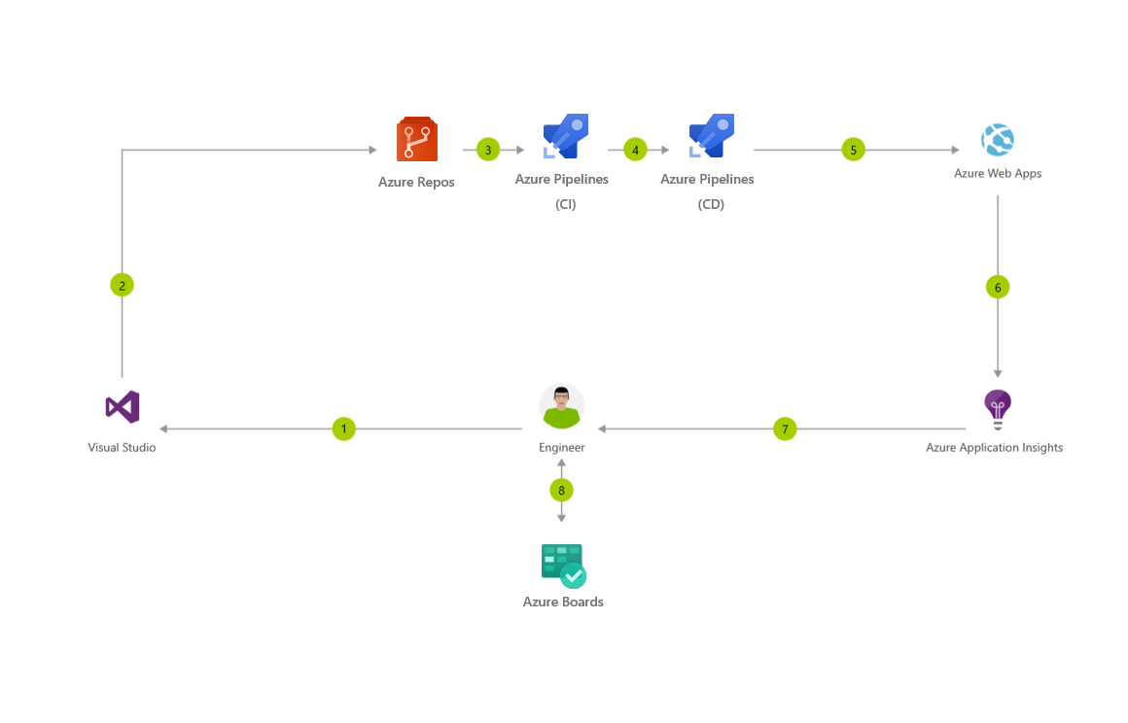
CI/CD for Azure Web Apps

Slide 33
Demo
Notes:
Demo : dev.azure.com

Slide 34
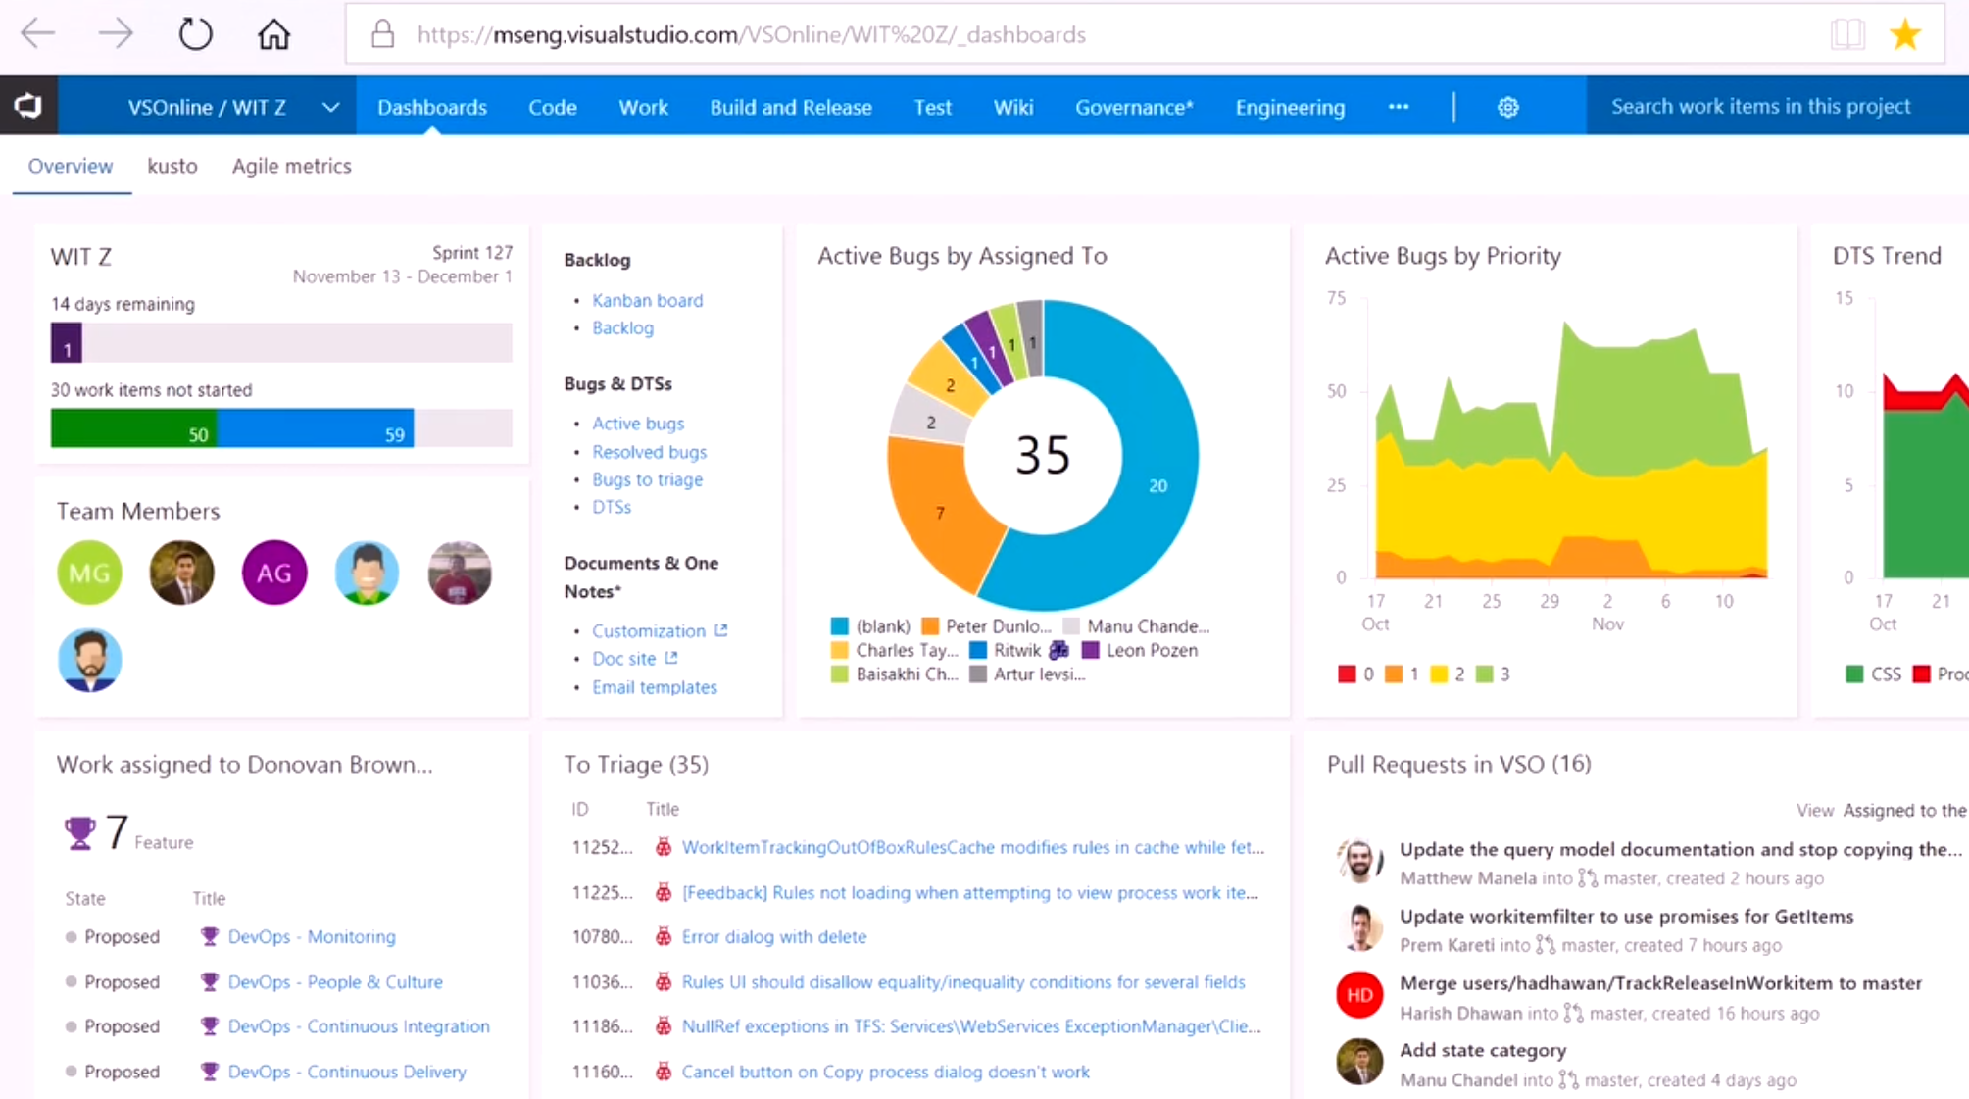
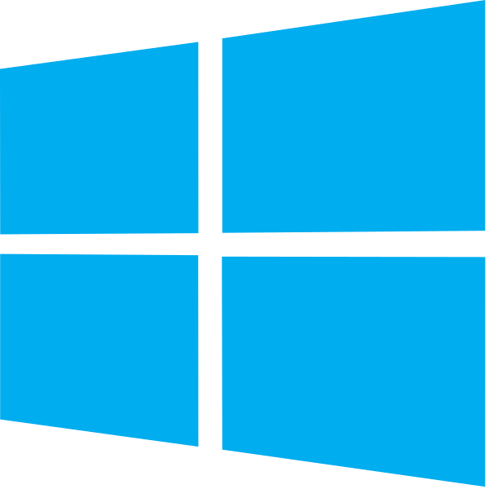

DevOps at Microsoft
DevOps at Scale
Visual Studio Team Services is the toolchain of choice for Microsoft engineering
+85,000
Engineers at Microsoft are using VSTS
Windows Engineering Team
VSTS Engineering Team
VSTS scales to host the world’s largest Git repo
Embracing DevOps practices = More value to customers
300GB Source code
More features delivered to customers in 2016 than in previous 4 years combined
3.5M Files
4,000+ Devs
http://aka.ms/devopsatmicrosoft

Slide 35
Resources
Azure DevOps YouTube Channel – See It
https://www.youtube.com/channel/UC-ikyViYMM69joIAv7dlMsA
Azure DevOps Hands-On Labs – Do It
https://www.azuredevopslabs.com/
Azure DevOps Documentation – Read about It
https://docs.microsoft.com/en-us/azure/devops
Azure DevOps Projects- Get Started Fast
https://azure.microsoft.com/en-us/features/devops-projects/

Slide 36
















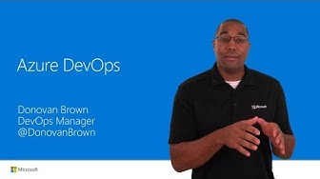



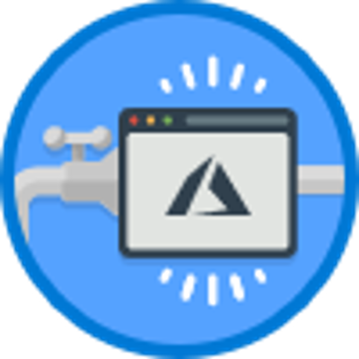
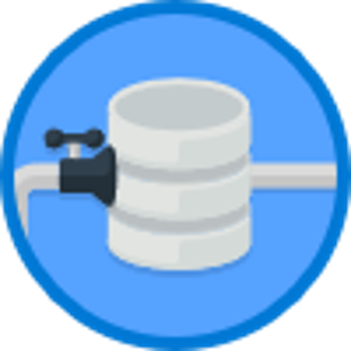

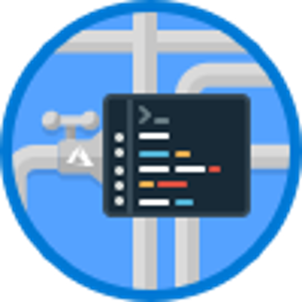

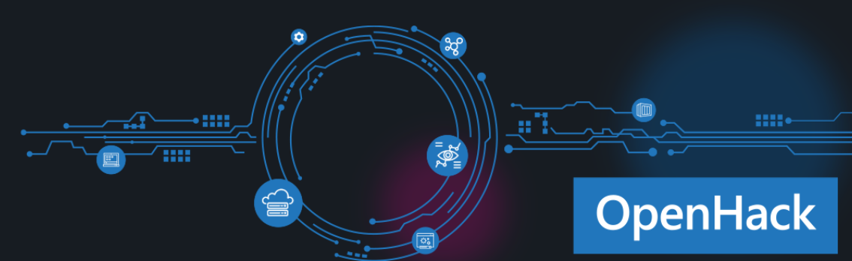


Learning path for Azure DevOps
What is DevOps?
DevOps is the union of people, process, and products to enable continuous delivery of value to our end users. Essential DevOps practices include agile planning, continuous integration, continuous delivery, and monitoring of applications.
START HERE
Short intro videos
What is Azure DevOps?
1.5 Min video
Intro to Azure DevOps
5 min video
MICROSOFT LEARN
Follow a learning path:
Or browse ala carte:
Become a Microsoft Certified Professional
Certification helps establish your credentials with current and future employers.
Try an interactive tutorial
Evolve your DevOps Practice
1hr 17 min
Getting Started with Azure DevOps
22 min
Asses your existing software development process
17 min
Create a build pipeline with Azure Pipelines
1 hr 3 min
Host your own build agent in Azure Pipelines
48 min
Implement a code workflow in your build pipeline using Git and GitHub
1 hr 13 min
Scan open source components for vulnerabilities and license ratings in Azure Pipelines
27 min
Build Applications with Azure DevOps
6 hr 10 Min
DEEP DIVE
Explore Azure DevOps Labs
Attend a DevOps OpenHack
https://www.azuredevopslabs.com/
OpenHack

